Slide 1
INSTRUCTIONS
Use Font size 22 to 28 and Font Style Times New Roman (body)
Do not change the Template: Heading / Title of the slides
Do not change font style or colours
Do not copy paste paragraphs: use only Bullet Points
Maximum slide Limit is 20 only
As per the number of supervisor allotted adopt slide-2 or slide-3
Please display the required meaningful Content or images or tables
Change the footer accordingly using insert tab then click on header & footer tab and edit it
Save the PPT with Register No, Dept and Review no, example: 23xxxxxxxxx_CSE

Slide 2

Title : NEXORA EVENT DYNAMIC CONNECT
Student Name: G.Laasya
Student ID: 2520030118
Cluster: 3
Section: 11
Under the Guidance
of
Supervisor Name: Mrs.Surekha
Assistant Professor
Department of CSE

Slide 3
OUTLINE
Abstract
Existing System
Proposed System
System Architecture
Project Modules
Objectives
Co’s Attainments - FWD
Co1
Co2 …….. 5. Co5
Co’s Attainments - DSA
Co1
Co2 …….. 5. Co5
Screen Shots for FWD & DSA
Conclusion
Geo-Tagged Photos

Slide 4
Abstract
Nexora Dynamic Event Connect is a web-based event management and booking platform.
It allows users to discover events, view details, and book tickets easily in one place.
The system provides a secure login, user-friendly dashboard, and smooth navigation.
It helps connect event organizers with participants through a digital platform.
Sorting and searching algorithms are used to arrange events and improve performance.
The frontend is developed using HTML, CSS, and JavaScript for a responsive interface.
The backend uses Java Servlets with JDBC connected to a MySQL database.
An admin module allows adding, updating, and deleting events.
The system also tracks bookings, trending events, and revenue statistics.
Overall, it is a scalable and efficient solution for managing and booking events.

Slide 5
Existing System
User Registration and Login are implemented using HTML forms, CSS styling, and JavaScript validation, while DSA data structures (arrays/lists) are used to manage and store user data.
After login, users access a dashboard designed with HTML and CSS cards, where DSA counters and variables calculate and display Total Events and Total Bookings dynamically.
Event details such as name, venue, city/state, date, time, price, seats, and popularity are displayed using dynamic frontend layouts, while structured data collections (arrays/objects) store and organize event information.
Users can search events by name, city, or state through JavaScript-based search features, supported by DSA searching techniques for faster and accurate results.
Users can filter events by city or state using interactive frontend controls, while DSA-based filtering logic processes and displays the required events.
Users can sort events by price, date, or popularity, applying sorting algorithms from Data Structures and Algorithms (DSA) to organize event lists efficiently.
Users can book tickets and view their booking history, where DSA data structures are used to store and manage booking records.
The user interface is built using HTML, CSS, and JavaScript with a gradient background and card-based design, creating a simple, responsive, and user-friendly experience.

Slide 6
Proposed System
Secure user registration and login implemented using HTML forms, CSS, and JavaScript validation, while DSA techniques manage encrypted user data in the database.
Persistent database (MySQL/MongoDB) stores users, events, and bookings, organized using efficient data structures.
Admin panel built with frontend technologies allows adding, editing, and deleting events, while backend logic manages event data.
Dynamic event display with images, categories, and details created using interactive frontend design and structured data storage.
Advanced booking system supports real-time seat tracking and confirmations, using DSA logic to manage seat availability and bookings.
Enhanced search and filters (price range, event type, popularity, date) implemented with JavaScript UI controls and DSA searching/filtering techniques.
Sorting features and personalized recommendations apply sorting algorithms for better user experience.
Analytics dashboard shows booking trends, revenue, and popular events using data processing and visualization.

Slide 7
System Architecture
User Interface (UI)
HTML pages (loginBox, registerBox, dashboard)
CSS for styling: gradients, cards, buttons, forms
Frontend Logic (JavaScript)
Handles user interactions: login, registration, logout
Displays events dynamically
Implements search, filter, sort, and booking functions
Data Storage (Temporary in JS arrays)
users[] → stores usernames & passwords
bookings[] → stores booking history
events[] → stores predefined events with details
Dashboard Rendering
Updates total events, total bookings
Shows booking history
Displays filtered/sorted events

Slide 8
Project Modules
Module 1: Authentication — Login and Register system using HTML forms and JavaScript validation; user session maintained with dashboard access and logout functionality.
Module 2: Event Data Management — Dynamic event dataset generation for multiple festivals across different states and cities; structured event objects store name, venue, price, date, seats, and popularity.
Module 3: Dashboard Overview — User dashboard with welcome navbar, stat cards for Total Events and Total Bookings, and dynamic DOM updates.
Module 4: Event Discovery — Search functionality to find events by name, city, or state, using filtering operations on the event dataset.
Module 5: Location Filtering — State and city dropdown filters with dynamically populated city lists for location-based event browsing.
Module 6: Event Sorting — Sorting algorithms applied to arrange events by price, date, or popularity for better event discovery.
Module 7: Ticket Booking System — Users can book tickets, seats are reduced dynamically, and booking records are stored in a booking list.
Module 8: Booking History — Displays user booking history with dynamically updated event list and booking counters.
Module 9: UI & Responsive Design — Modern interface built with HTML, CSS, and JavaScript, featuring cards, gradient backgrounds, interactive buttons, and responsive layout.

Slide 9
Objectives
To develop a user-friendly web interface using HTML, CSS, and JavaScript for easy navigation and interaction with the event booking system.
To implement secure user authentication with registration and login functionality, ensuring proper management of user data.
To store and manage event and booking information using data structures such as arrays and objects for efficient data handling.
To apply searching algorithms that allow users to quickly find events by name, city, or state.
To implement sorting algorithms to arrange events based on price, date, and popularity for better event discovery.
To design a dynamic dashboard that displays total events and total bookings using JavaScript DOM manipulation.
To develop an efficient ticket booking system where seat availability is updated dynamically after each booking.
To enhance user experience through responsive design and interactive UI components.
To demonstrate the practical integration of Data Structures and Algorithms with modern web technologies in a real-world event management application.

Slide 10
Co’s Attainments - FWD
CO1: Apply Internet fundamentals, HTML, and introductory CSS styling to create the website layout, including login/register forms, dashboard, and event cards.
CO2: Apply HTML forms, semantic tags, and CSS layouts to design structured and responsive pages like registration forms, event listings, filters, and the dashboard interface.
CO3: Apply JavaScript programming essentials to implement functionalities such as user registration/login, event data handling, and ticket booking.
CO4: Apply JavaScript interactivity and DOM manipulation to make the website dynamic and interactive: filtering/searching events, sorting, updating booking history, and real-time stats.
CO5: Apply advanced web development concepts for further enhancements, including form validation, localStorage for user persistence, and deploying the website for users.

Slide 11
Co’s Attainments - DSA
CO1: Searching and Sorting
Implemented search functionality to find events by name, city, or state.
Applied sorting algorithms to arrange events by price, date, and popularity.
CO2: Lists (ADT)
Used arrays and objects to store and manage users, events, and bookings.
Enabled insertion, deletion, and traversal operations on event and booking data.
CO3: Stacks and Queues
Managed booking history in sequential order, similar to queue operations.
Processed booking records dynamically when users book tickets.
CO4: Hashing
Implemented state–city mapping structure for fast data retrieval.
Enabled efficient lookup of cities based on selected states.

Slide 12
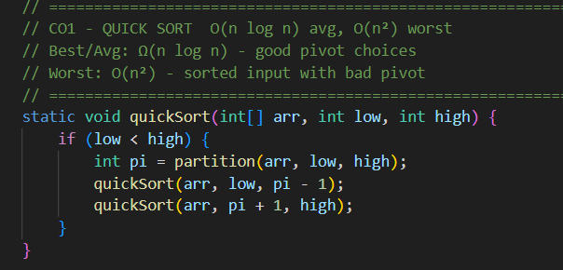
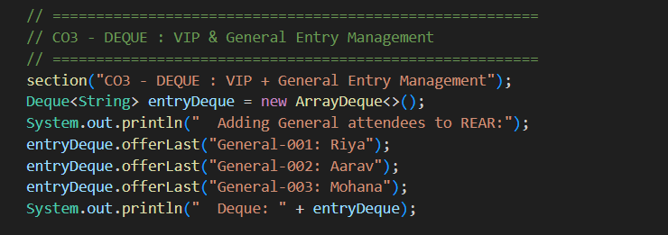
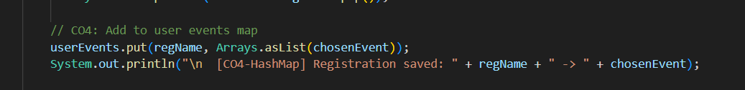
Screenshots for FWD & DSA

Slide 13
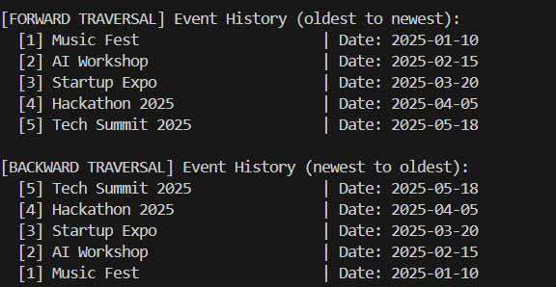
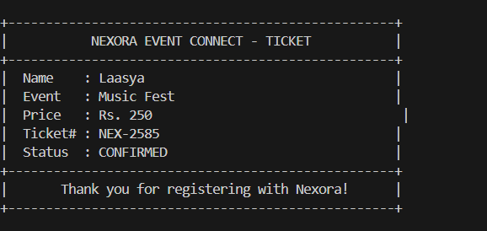
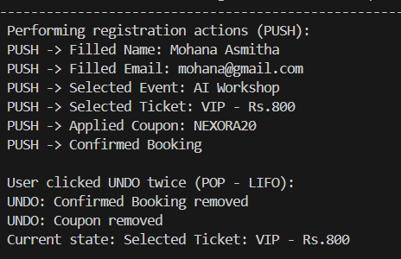
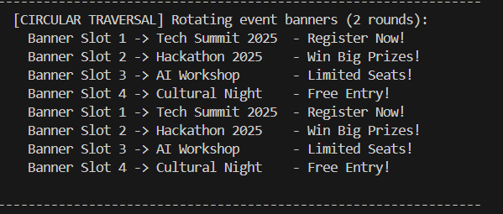
Screenshots for FWD & DSA

Slide 14
Conclusion
The Nexora Dynamic Event Connect website is a fully functional platform designed to manage events efficiently in a digital environment. It allows users to register, browse events, book tickets, and manage their booking history in an organized and user-friendly manner. The project uses Front-End Web Development technologies such as HTML, CSS, and JavaScript to create a responsive and interactive interface that works smoothly across different devices. At the same time, it demonstrates the practical application of Data Structures and Algorithms, where arrays and objects are used to manage event and booking data, and searching and sorting techniques help users quickly find and organize events based on price, date, and popularity. By combining efficient data handling with an attractive and responsive user interface, the project shows how DSA concepts and modern web technologies can work together to build a scalable, efficient, and engaging event management system.

Slide 15
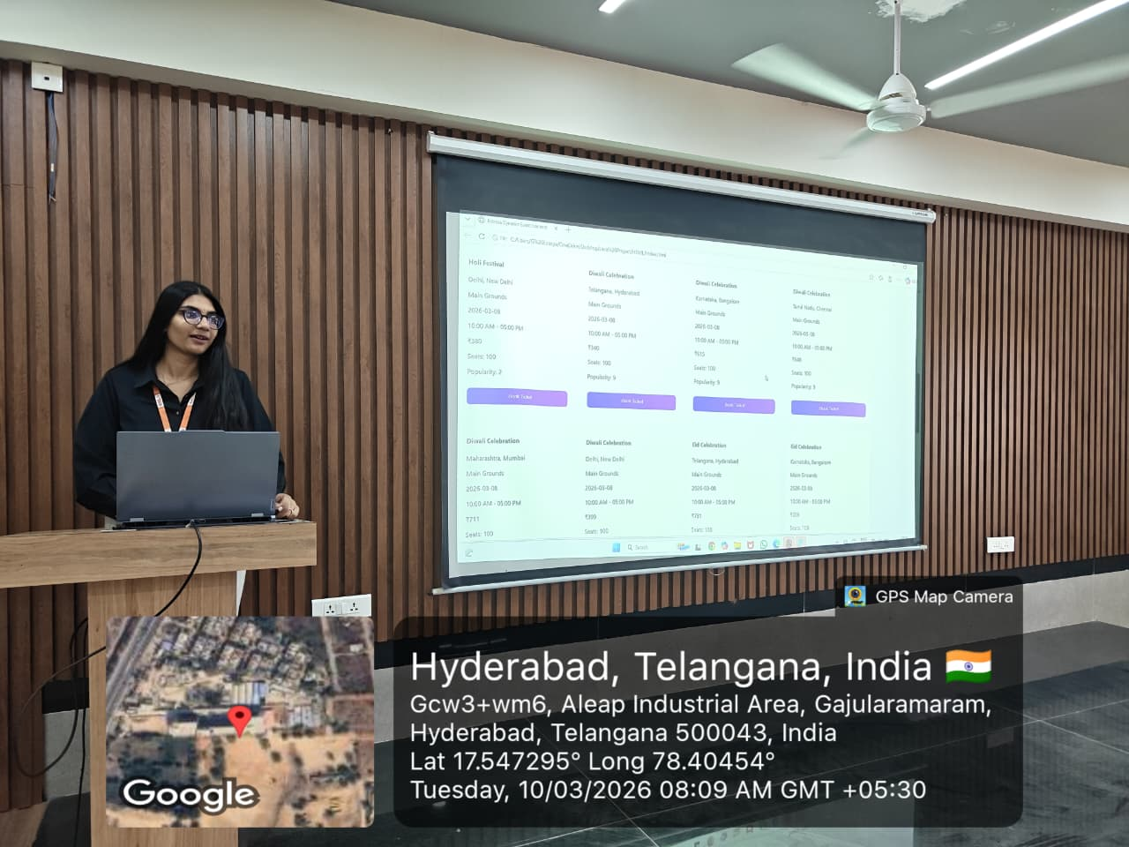
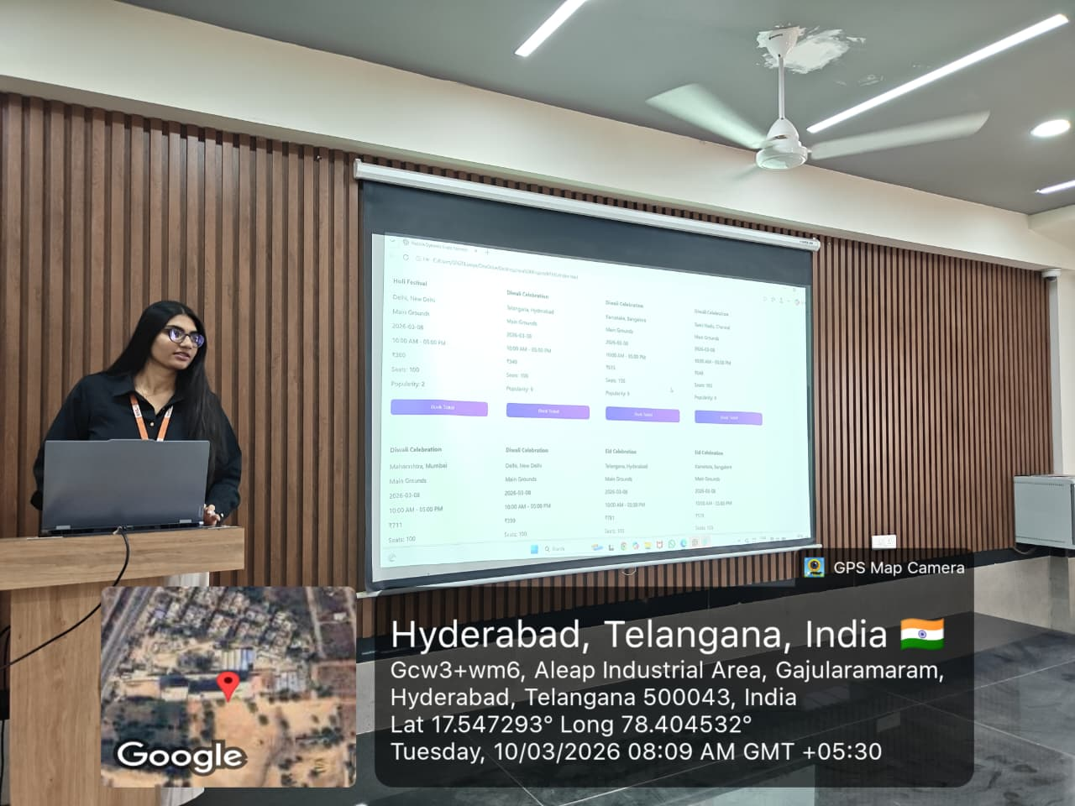
Geo- Tag Photos

Slide 16
THANK YOU

